Slide 1
Employee Data Analysis using Excel
STUDENT NAME: J HARINI
REGISTER NO: 312215825
DEPARTMENT: B COM (ACCOUNTING AND FINANCE)
COLLEGE: SHRI SHANKARLAL SUNDARBAI SHASUN JAIN COLLEGE FOR WOMEN

Slide 2
PROJECT TITLE
Employee Performance Analysis using Excel

Slide 3


AGENDA
Problem Statement
Project Overview
End Users
Our Solution and Proposition
Dataset Description
Modelling Approach
Results and Discussion
Conclusion
3/21/2024 Annual Review

Slide 4

PROBLEM STATEMENT
To analyze current employee performance data to identify their performance.
To determine the primary factors influencing performance, including individual, managerial, and organizational variables.
To assess the effectiveness of existing performance management practices and their impact on performance outcomes for the development of the organization.
To develop actionable recommendations to enhance overall employee performance and align it with organizational goals.

Slide 5

PROJECT OVERVIEW
An employee performance analysis is a systematic process aimed at evaluating and improving the effectiveness and productivity of employees within an organization.
.
We need to identify the causes affecting performance levels, such as skill gaps, motivation, managerial effectiveness, and work environment.
This analysis will focus on employees across all departments, evaluating performance metrics for the past 12 months. The study will include a review of performance appraisal data, employee surveys, manager feedback, and training records.
The analysis will provide a clear understanding of the root causes of performance issues and offer targeted recommendations to improve performance management strategies, enhance employee engagement, and boost overall productivity.

Slide 6





WHO ARE THE END USERS?
Human Resources (HR) Department:
Identifies training needs, designs career development plans, creates performance improvement plans, and aligns performance with organizational goals.
Team Leaders:
Use the data to provide constructive feedback, conduct performance reviews, and set individualized development goals.
Project Managers:
Analyze performance data to allocate resources effectively, assign tasks based on strengths, and identify potential leaders for specific projects.
Chief Executive Officers (CEOs) and Chief Operating Officers (COOs):
Utilize performance analysis to understand overall organizational health, identify potential leaders, and drive strategic initiatives.

Slide 7
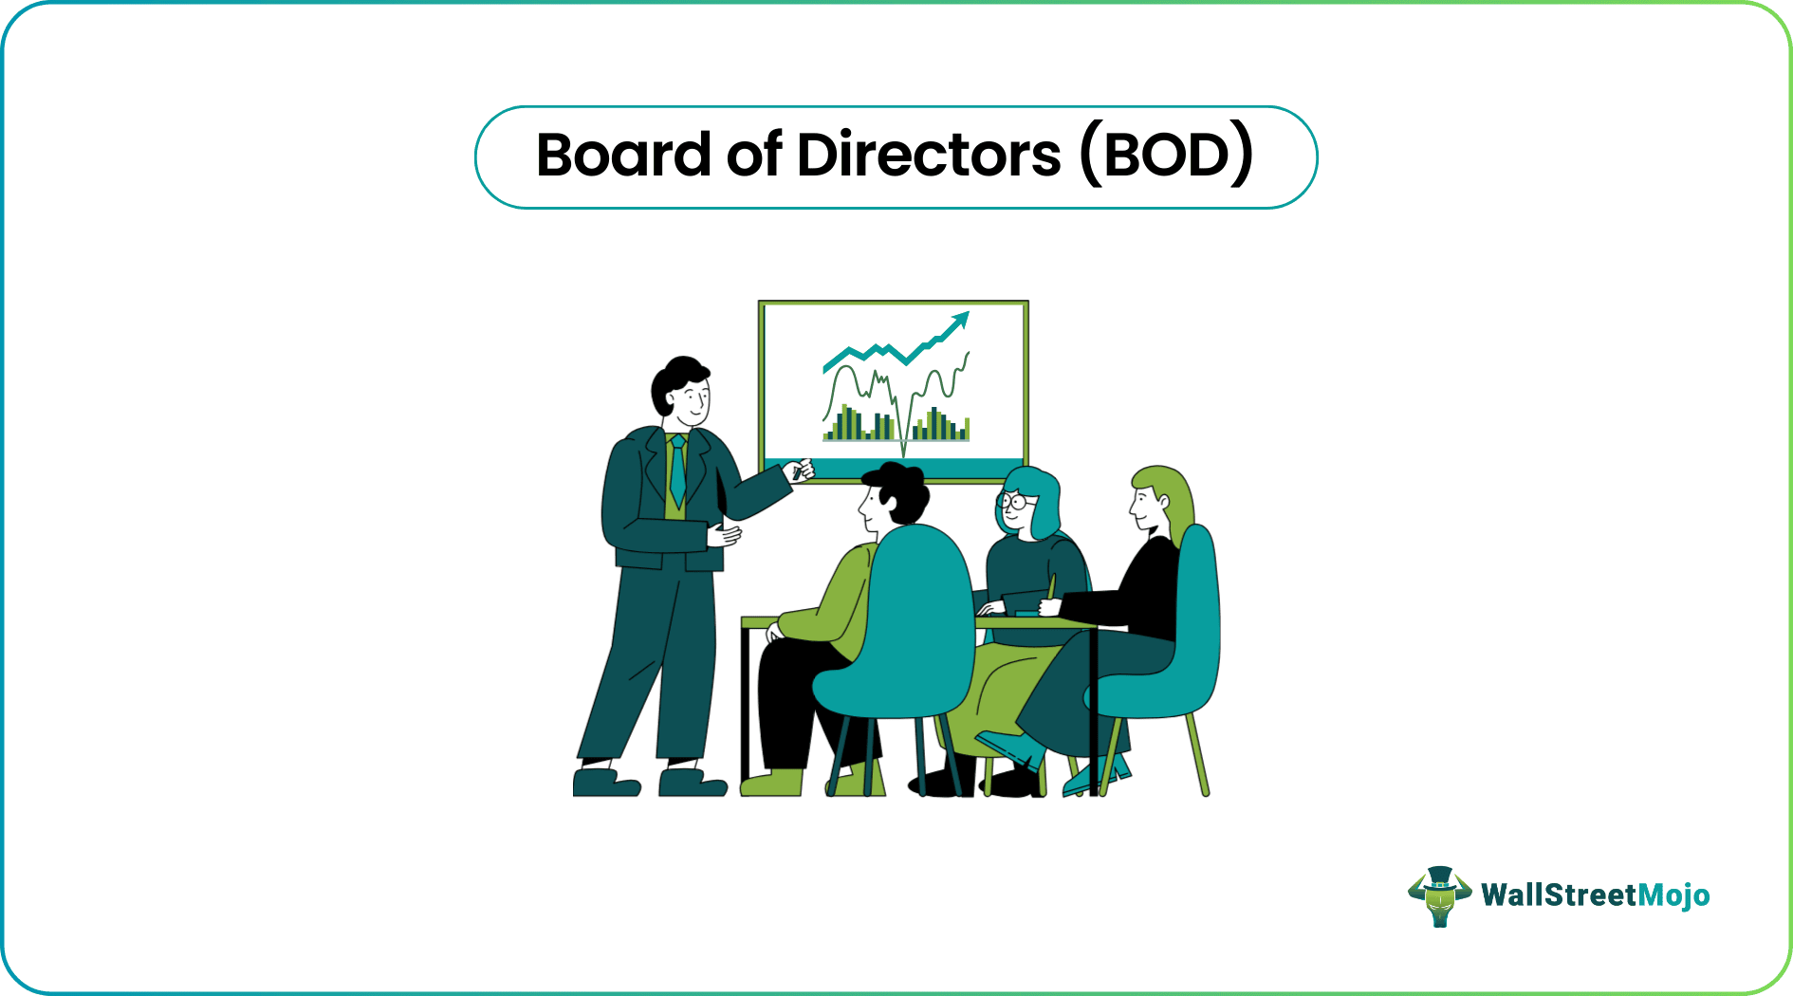
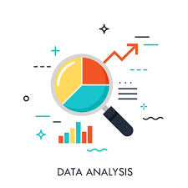
Performance Review Committees: Committees or boards that conduct regular performance reviews use this data to ensure a fair, unbiased, and comprehensive review process. Make recommendations for promotions, raises, transfers, or terminations based on performance data. Organizational Development (OD) Consultants: External or internal consultants analyze performance data to provide insights on organizational culture, team dynamics, and change management. Help organizations create a more effective and engaged workforce by identifying systemic issues impacting performance. Business Analysts and Data Scientists: Use performance data to build predictive models that can forecast turnover, identify high-potential employees, and suggest strategies for workforce optimization. Provide deeper insights into trends, correlations, and causations related to employee performance. Board of Directors: The board uses performance analysis to understand the effectiveness of senior management, ensure strategic alignment, and evaluate organizational performance.

Slide 8

OUR SOLUTION AND ITS VALUE PROPOSITION
Conditional formatting: Enhances data visualization and help you quickly identify trends and anomalies, making your data analysis more efficient and effective.
Filters: Manages large datasets, enabling you to focus on specific segments of data and make informed decisions based on the filtered results.
Formulas: Performs a wide range of tasks from basic arithmetic to complex data analysis to analyze data, automate tasks, and make informed decisions
.
PivotTables: Powerful tools for data analysis that allow you to summarize, analyze, explore, and present data in various ways. It allows you to easily reorganize and summarize selected columns and rows of data to obtain the desired report without altering the original data.
Graphs: Represent data in a graphical format, making it easier to understand patterns, trends, and relationships in your data. Depending on the nature of your data and the kind of analysis you can choose the graph.

Slide 9
Dataset Description
Employee dataset downloaded from edunet
Total features = 26
Considered features = 11
The considered features are listed below:
Employee ID - Number
First Name - Text
Last Name - Text
Business Unit - Text
Employee Status - Text
Employee Type - Text
Employee Classification Type - Text
Gender Code – Male / Female
Performance Score - Text
Current Employee Rating – Number
Performance Level - Text

Slide 10

THE "WOW" IN OUR SOLUTION
Performance Level Calculation:
=IF(AND(Z2>=5),"VERY HIGH",IF(AND(Z2>=4),"HIGH",IF(AND(Z2>=3),"MED","LOW")))
3/21/2024 Annual Review
10

Slide 11
MODELLING
Data Collection:
Employee Dataset downloaded from edunet
Features Collection:
Employee id
First Name
Last Name
Business Unit
Employee Status
Employee Type
Employee Classification Type
Gender Code
Performance Score
Current Employee Rating
Performance Level
11

Slide 12
Data Cleaning:
Indentifying missing values
Filtering of missing values
Performance Level:
Performance level is analyzed through Current Employee Rating
Formula used:
=IF(AND(Z2>=5),"VERY HIGH",IF(AND(Z2>=4),"HIGH",IF(AND(Z2>=3),"MED","LOW")))
Summary:
Pivot table field list:
Report Filter → Gender Code
Legend Fields → Performance Level
Axis Fields → Business Unit
Values → Count of First Name
Removing the blanks
Visualization:
Bar Diagram and Pie Chart done using the collected data.
Bar Diagram represents the performance level of all the employees.
Pie Chart shows the high performance level of the employees.

Slide 13
RESULTS: Bar Diagram →performance level of employees.
13

Slide 14
Pie Chart →the high performance level of the employees.

Slide 15




CONCLUSION: We can see that the steadiness of the medium level employees prevails in each and every department. Through the analysis, I conclude that the medium level employees are high in each department and these strategies can be used to enhance their performance which is crucial for the success of the organization. Provide Clear Goals and Expectations Offer Professional Development Opportunities Foster a Positive Work Environment Develop Effective Leadership and Management Use Data-Driven Performance Management Encourage Innovation and Creative Thinking

